Slide 1

Artificial
Intelligence
AI Viualizing Team

Slide 2
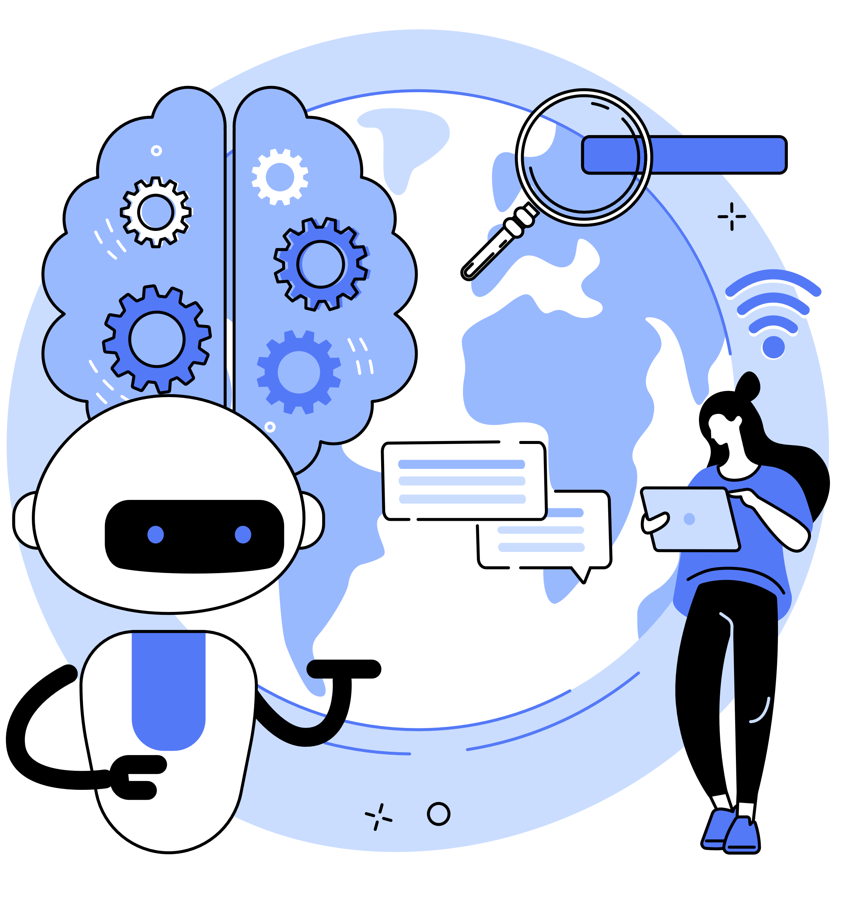
Contents
1
What is Artificial Intelligence?
2
How can we use AI?
3
What is Machine Learning and its types?
4
What are ML algorithms?
5
What is Deep Learning and its types?
6
What are DL algorithms?

Slide 3
Definition

Slide 4

What is Artificial Intelligence?
Artificial Intelligence (AI) is the use of computer systems to simulate human mental processes, such as interpreting and generating language.

Slide 5
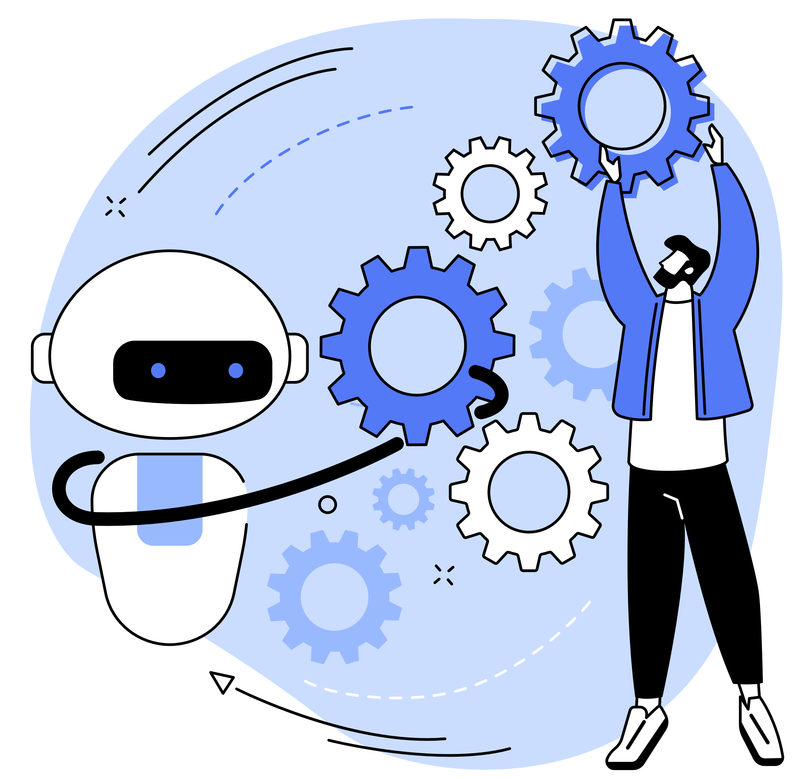
examples of Artificial Intelligence
Chatbots
Smart cars
Smart assistants
Navigation apps
E-Payments
Facial recognition
Search algorithms
Text editors
Media streaming
Social media feeds

Slide 6
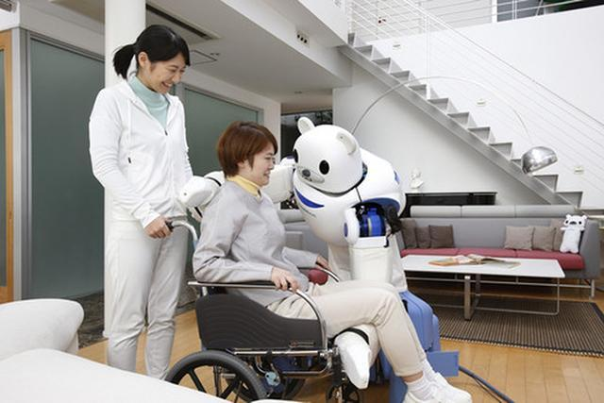
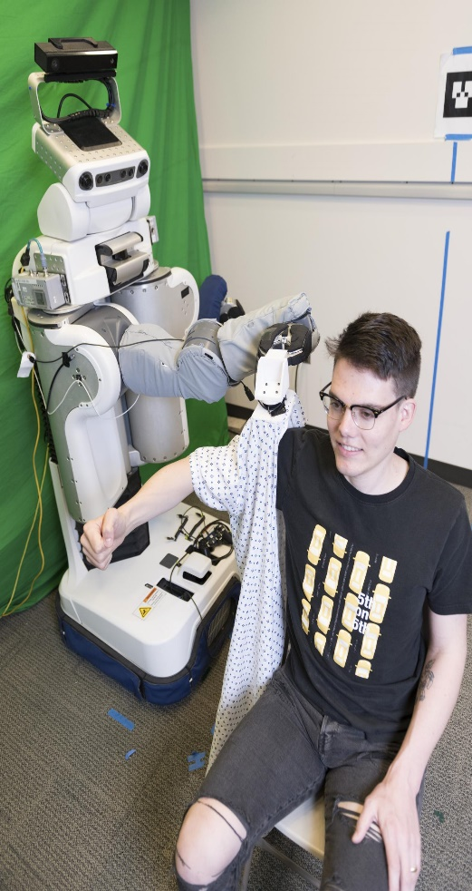
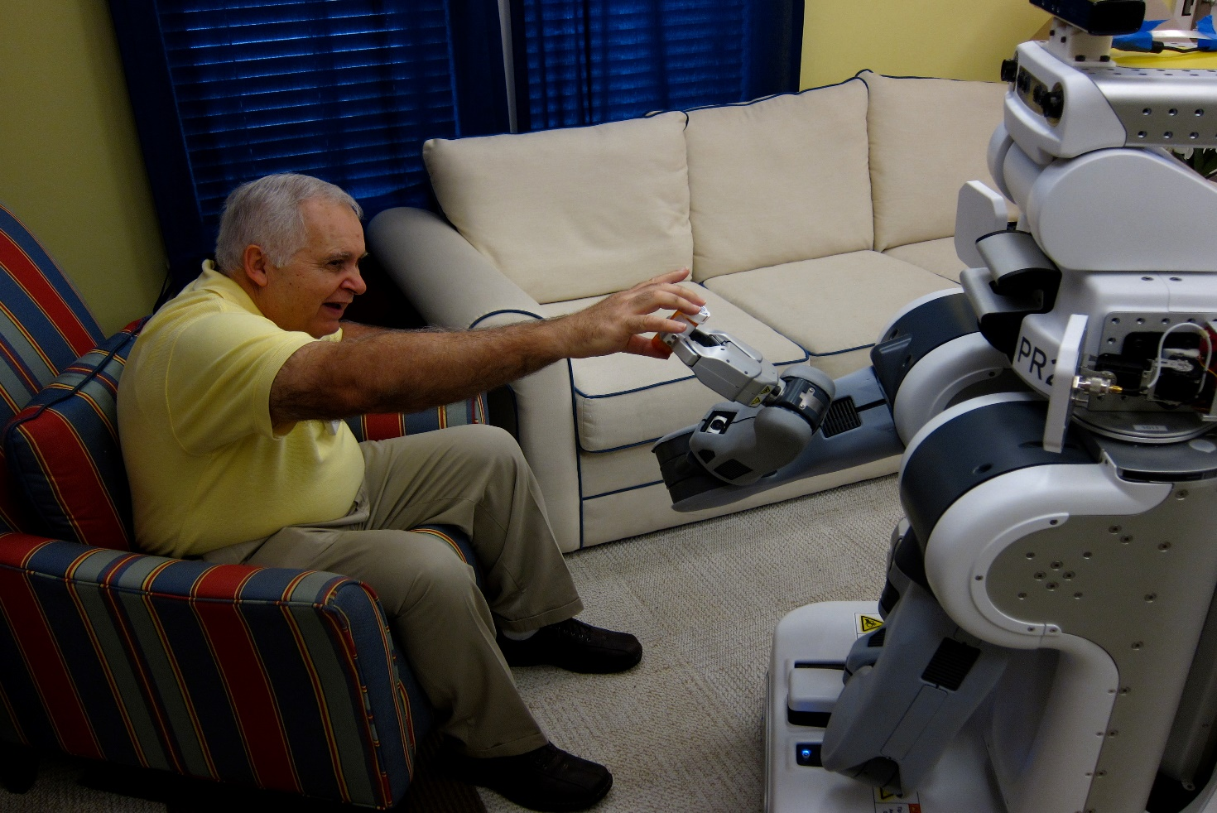
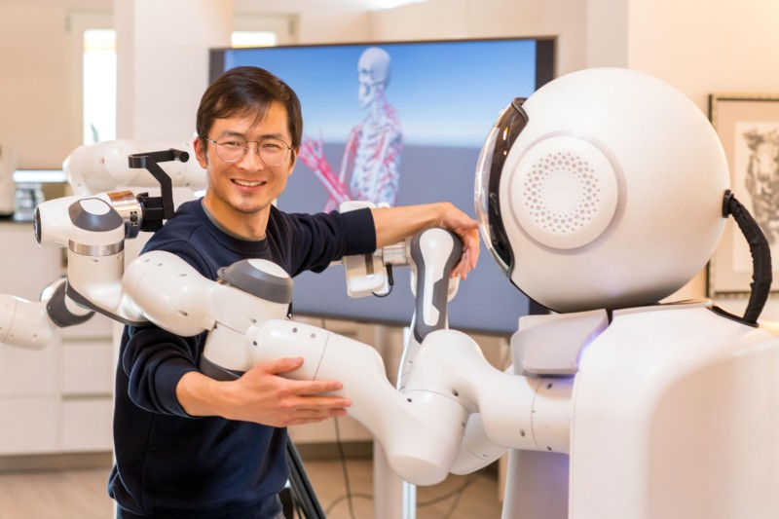
AI will not replace humans, but it is getting better and better at supporting us for this. We need an AI competent society.

Slide 7
Techniques

Slide 8
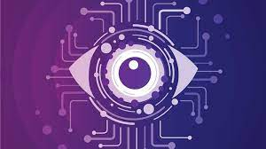
Computer Vision Technology in Business
Machine vision is a type of AI that enables machines to comprehend and interpret pictures and videos. AI’s machine learning algorithms are generally trained on images to identify and categorize items. It has a wide range of applications in many disciplines, including:
- Autonomous vehicles
- Healthcare
- Farming
- Manufacturing

Slide 9
Creative AI
AI has the potential to produce art, music, poetry, plays, and even video games. We can anticipate more complicated and “seemingly natural” creative output from our increasingly inventive and capable electronic pals in 2022 as new models like GPT-4 and Google’s Brain redefine the limits of what’s possible.

Slide 10
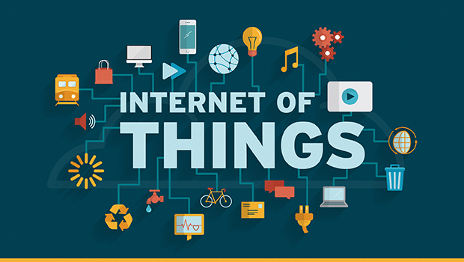
AI and IOT
The Internet of Things (IoT) is a term used to describe the growing number of automated devices connected to the internet. Many businesses and individuals are embracing this technology, but many tech companies still struggle with how to extract actionable insights from the flood of data coming from these gadgets. Leading-edge technologies, such as artificial intelligence (AI), or the concept of combining AI with IoT products, are beginning to address these pools of unused data, allowing AI to rapidly and intelligently parse it.

Slide 11
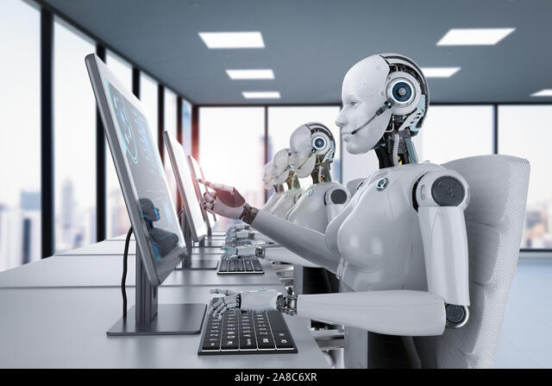
Robots and AI
A robot is a machine—especially one programmable by a computer—capable of carrying out a complex series of actions automatically. A robot can be guided by an external control device, or the control may be embedded within. Robots may be constructed to evoke human form, but most robots are task-performing machines, designed with an emphasis on stark functionality, rather than expressive aesthetics.

Slide 12
Machine Learning (ML)

Slide 13

What is Machine Learning?
Machine learning is a subfield of artificial intelligence that focuses on the development of algorithms and statistical models that enable computers to learn from data, without being explicitly programmed.
The goal of machine learning is to enable computers to learn patterns and make predictions or decisions based on data inputs, allowing them to automate tasks and improve decision-making accuracy over time.

Slide 14
Types of ML

Slide 15
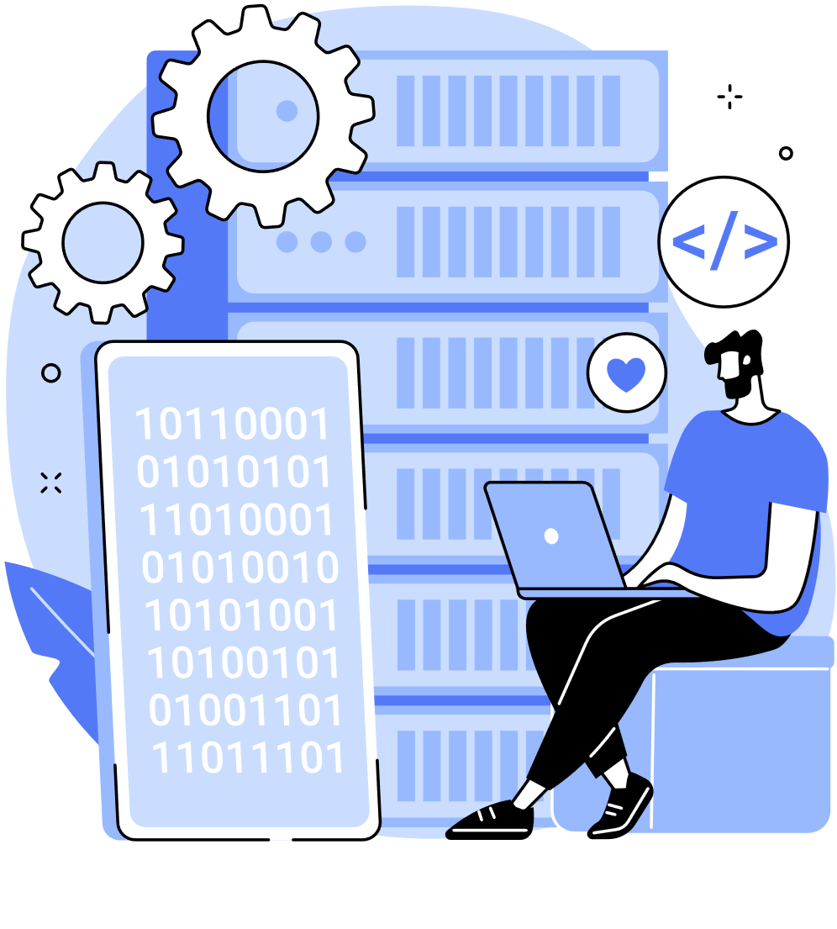
Supervised machine learning
Supervised machine learning is a type of machine learning where the algorithm learns from labeled training data to make predictions or take actions on new, unseen data. In supervised learning, the training data includes both input features and the correct outputs, and the algorithm uses this information to learn a mapping between inputs and outputs.
The objective is to train the model to generalize well to new data and correctly predict the output for previously unseen inputs.

Slide 16
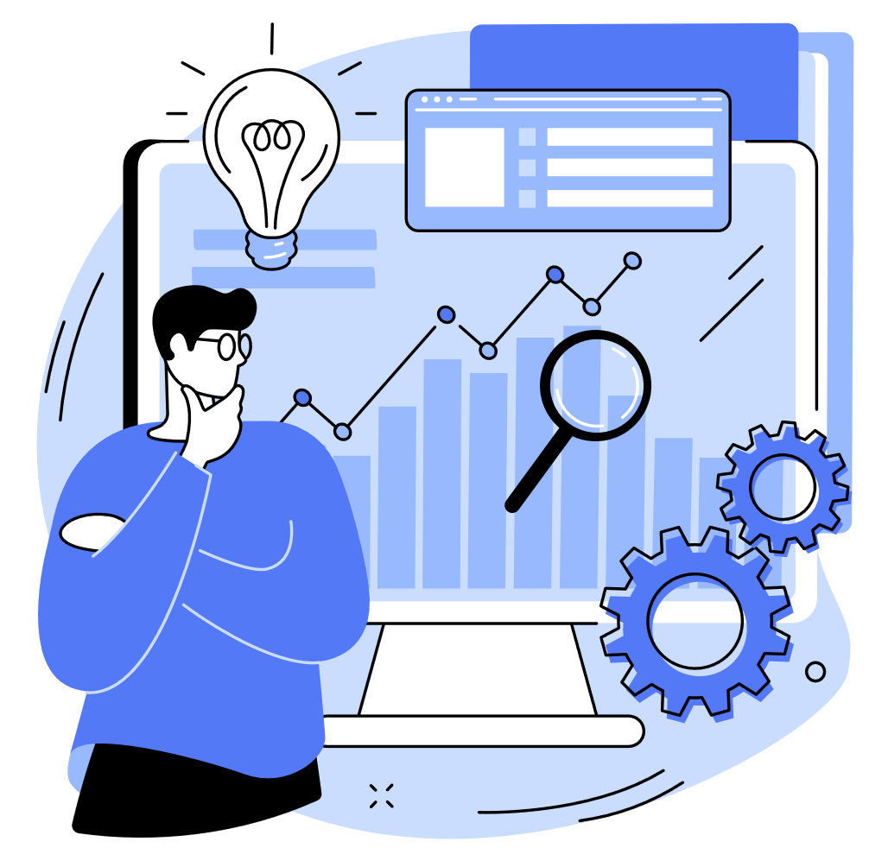
Unsupervised machine learning
Unsupervised machine learning is a type of machine learning where the algorithm is given a set of unlabeled data and must find patterns or relationships in the data without any prior knowledge or guidance.
Unlike supervised learning, unsupervised learning does not have labeled output data to train on. Instead, the algorithm must identify patterns and structure in the input data on its own.

Slide 17

Reinforcement learning
Reinforcement learning is a type of machine learning where an agent learns to make decisions by interacting with an environment and receiving feedback in the form of rewards or punishments.
• The goal of reinforcement learning is to learn a policy that maps states to
actions, so that the agent can maximize the cumulative reward over time.

Slide 18
ML Algorithms

Slide 19
ML Algorithms
Logistic Regression
Linear Regression
Support Vector Machines (SVM)
Decision Trees
Principal Component Analysis (PCA)
K-Means Clustering
Random Forest
K-Nearest Neighbors (K-NN)

Slide 20

The Data
BREAST CANCER

Slide 21
BREAST CANCER
Breast cancer is the most common cancer amongst women in the world. It accounts for 25% of all cancer cases, and affected over 2.1 Million people in 2015 alone.
It starts when cells in the breast begin to grow out of control. These cells usually form tumors that can be seen via X-ray or felt as lumps in the breast area.
The key challenges against it’s detection is how to classify tumors into malignant (cancerous) or benign(non cancerous).
We ask you to complete the analysis of classifying these tumors using machine learning (with SVMs) and the Breast Cancer Wisconsin (Diagnostic) Dataset.
سرطان الثدي هو السرطان الأكثر شيوعا بين النساء في العالم ، وهو يمثل 25% من جميع حالات السرطان، وقد أصاب وحده أكثر من 2.1 مليون شخص في عام 2015 .
ويبدأ عندما تبدأ الخلايا الموجودة في الثدي بالنمو خارج نطاق السيطرة.
عادة ما تشكل هذه الخلايا أورامًا يمكن رؤيتها بالأشعة السينية أو الشعور بها ككتل في منطقة الثدي.
تتمثل التحديات الرئيسية التي تواجه اكتشافها في كيفية تصنيف الأورام إلى خبيثة (سرطانية) أو حميدة (غير سرطانية). نطلب منك إكمال تحليل تصنيف هذه الأورام باستخدام التعلم الآلي (مع SVMs )
ومجموعة بيانات سرطان الثدي في ولاية ويسكونسن (التشخيصية).

Slide 22




WHAT IS OUR
OBJECTIVE ?
Calculate the Accuracy and the Time for each algorithm.
OBJECTIVE
Find the best algorithm which output the best Accuracy in a few time.

Slide 23
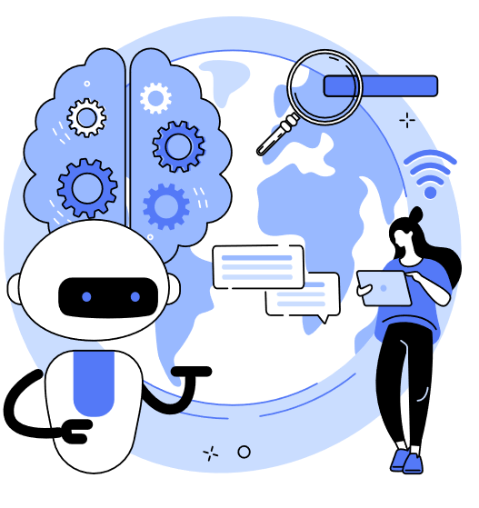
Regression Algorithms

Slide 24
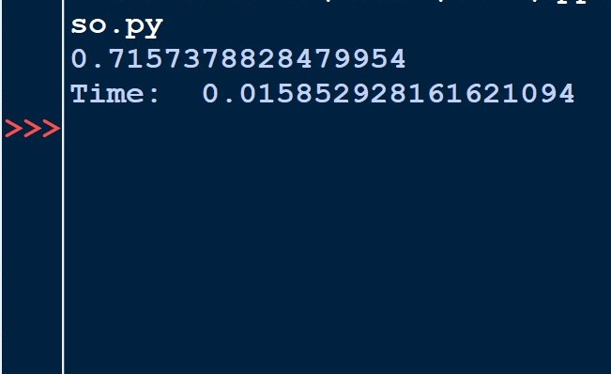
Lasso
The Lasso (Least Absolute Shrinkage and Selection Operator) algorithm is a linear regression technique used for feature selection and regularization. It is a type of regression analysis that combines the ordinary least squares (OLS) regression with regularization, specifically L1 regularization.

Slide 25
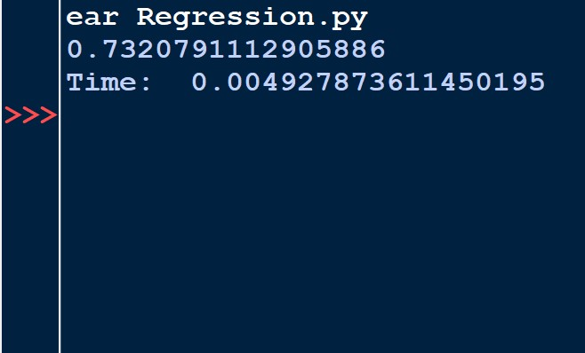
Linear Regression
Linear regression is a supervised machine learning algorithm used for modeling the relationship between a dependent variable (also known as the target or outcome) and one or more independent variables (predictors or features). It is one of the simplest and most widely used regression techniques for both predictive modeling and understanding the relationship between variables.

Slide 26
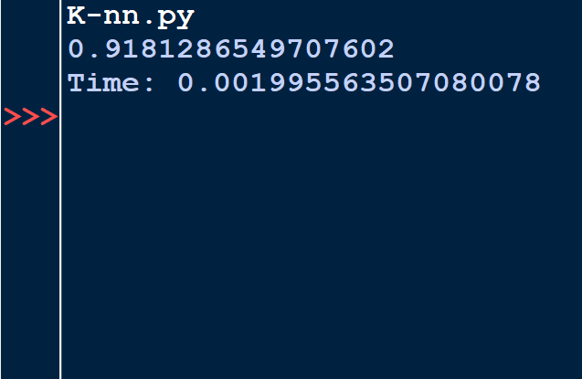
K-Nearest Neighbors
The k-Nearest Neighbors (K-NN) algorithm is a simple and popular supervised machine learning algorithm used for classification and regression tasks. It is considered a non-parametric and instance-based algorithm because it doesn't make strong assumptions about the underlying data distribution and relies on the entire training dataset for making predictions.

Slide 27
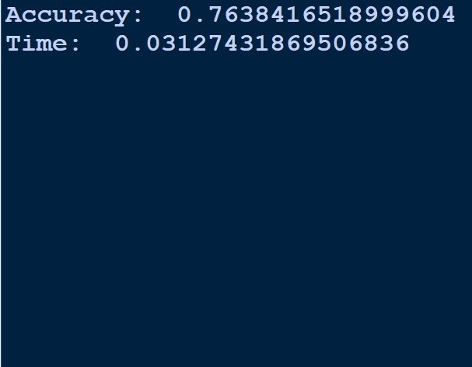
SVR
Support Vector Regression (SVR) is a machine learning algorithm used for regression tasks. Unlike traditional regression algorithms, SVR aims to find a function that best fits the data while simultaneously minimizing the error within a specified tolerance or margin of error. SVR is a member of the Support Vector Machine (SVM) family, which includes Support Vector Classification (SVC) for classification tasks.

Slide 28
Classification Algorithms

Slide 29
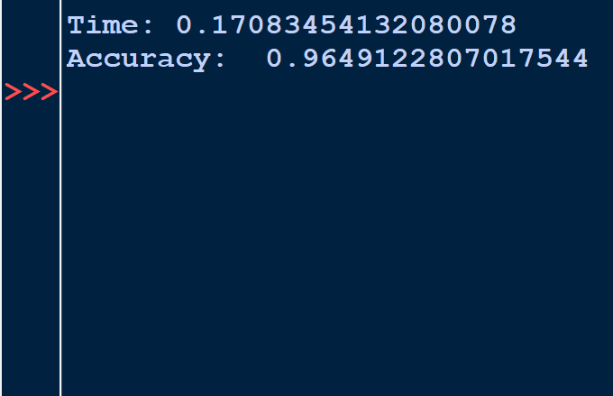
Random Forest
Random Forest is an ensemble learning algorithm that is used for both classification and regression tasks. It is a powerful and versatile machine learning technique that combines multiple decision trees to create a more robust and accurate model. Random Forest is often favored for its ability to handle complex data, avoid overfitting, and provide feature importance rankings.

Slide 30
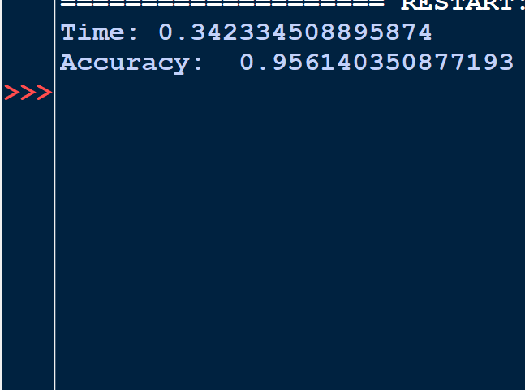
Gradient Boosting Classifier
The Gradient Boosting Classifier is a powerful ensemble machine learning algorithm used for both classification and regression tasks. It is a member of the boosting family of algorithms and is known for its ability to create highly accurate predictive models by combining the predictions of multiple weak learners (typically decision trees) in a weighted fashion. Gradient Boosting Classifier is often used in machine learning competitions and real-world applications due to its strong predictive performance.

Slide 31
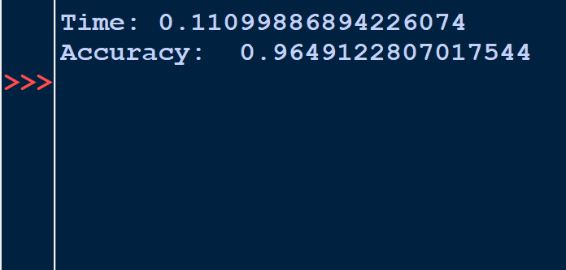
Logistic Regression
Logistic Regression is a statistical and machine learning algorithm used for binary classification and, with some modifications, for multi-class classification. Despite its name, it's not a regression algorithm but a classification algorithm. It's widely used in various fields, including medicine, social sciences, engineering, and machine learning.

Slide 32
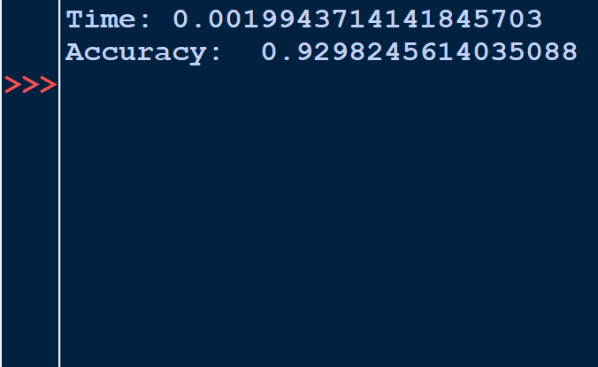
K-Neighbors Classifier
The K-Neighbors Classifier (K-NN Classifier) is a supervised machine learning algorithm used for classification tasks. It is a simple yet effective algorithm that makes predictions based on the majority class among its k-nearest neighbors in the feature space. In other words, K-NN classifies data points based on the class labels of their closest neighbors in the training dataset.

Slide 33
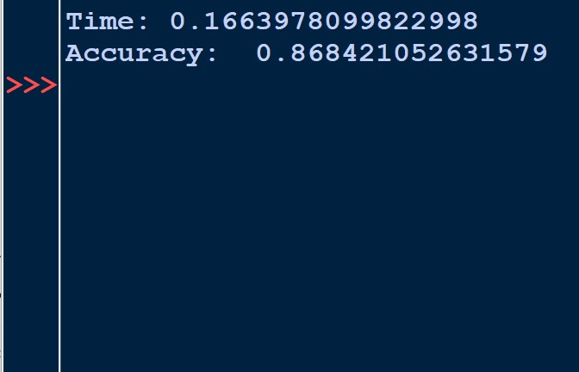
K-Means
K-Means is a popular unsupervised machine learning algorithm used for clustering data points into groups or clusters based on their similarity. The goal of K-Means is to partition a dataset into K clusters, where each data point belongs to the cluster with the nearest mean (centroid). It is a partitional clustering algorithm that assigns each data point to one of the K clusters.

Slide 34
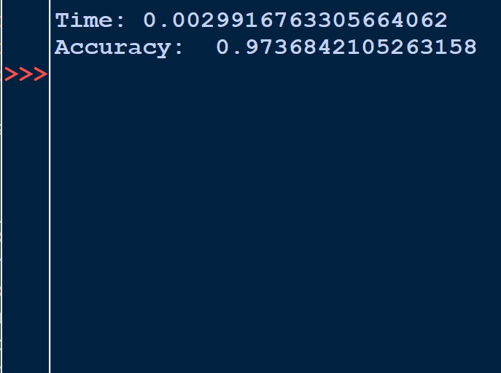
Naïve Bayes
Naïve Bayes is a supervised machine learning algorithm primarily used for classification tasks, such as spam email detection and sentiment analysis. It is based on Bayes' theorem and is particularly effective when dealing with high-dimensional data and text classification problems.

Slide 35
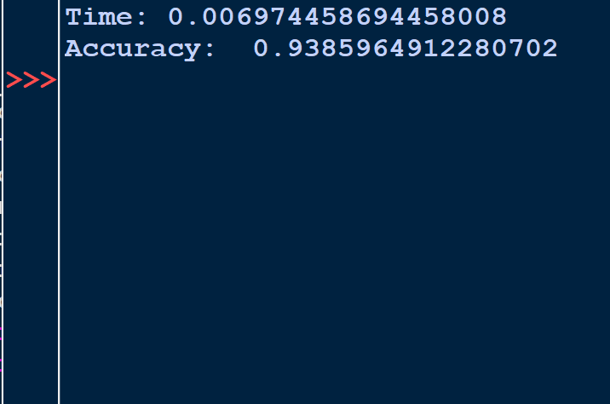
Decision Tree
A Decision Tree is a supervised machine learning algorithm used for both classification and regression tasks. It is a popular choice for its simplicity, interpretability, and the ability to handle both categorical and numerical data. A Decision Tree works by recursively partitioning the dataset into subsets, with the goal of creating homogeneous groups of data points within each subset.

Slide 36
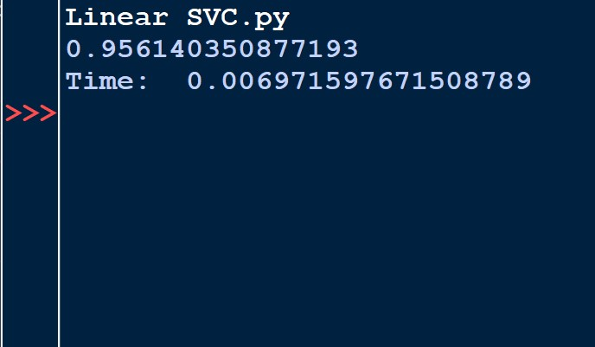
Linear SVC
A Linear Support Vector Classifier (Linear SVC) is a type of supervised machine learning algorithm used for binary classification tasks. It is part of the Support Vector Machine (SVM) family of algorithms, which are known for their effectiveness in finding a hyperplane that best separates two classes in a high-dimensional feature space.

Slide 37
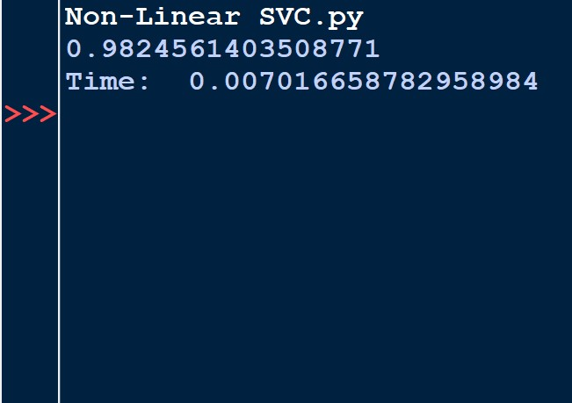
Non-Linear SVC
A Non-Linear Support Vector Classifier (Non-Linear SVC) is an extension of the Support Vector Machine (SVM) algorithm designed to handle classification problems where the data is not linearly separable in its original feature space. Unlike the Linear SVC, which works with linearly separable data, Non-Linear SVC uses various kernel functions to map the data into a higher-dimensional space where it becomes linearly separable.

Slide 38
Deep Learning (DL)

Slide 39

What is Deep Learning?
Deep learning is a subfield of machine learning that focuses on neural networks with many layers, also known as deep neural networks.
It is inspired by the structure and function of the human brain, where information is processed through interconnected neurons.

Slide 40
Types of deep learning
Convolutional Neural Networks (CNNs)
Feedforward Neural Networks (FNNs)
Autoencoders
Recurrent Neural Networks (RNNs)
Autoencoders are a type of neural network used for unsupervised learning and dimensionality reduction. They consist of an encoder and a decoder and are often used for tasks such as data compression, denoising, and anomaly detection.
These are the simplest form of deep learning models, consisting of an input layer, one or more hidden layers, and an output layer. Each layer contains neurons (nodes) connected to neurons in the adjacent layers.
RNNs are designed for sequential data, where the order of the data points matters. RNNs are commonly used in natural language processing (NLP), speech recognition, and time series analysis.
CNNs are designed to automatically and adaptively learn spatial hierarchies of features from input data .CNNs have been highly successful in image classification, object detection, and image generation.

Slide 41
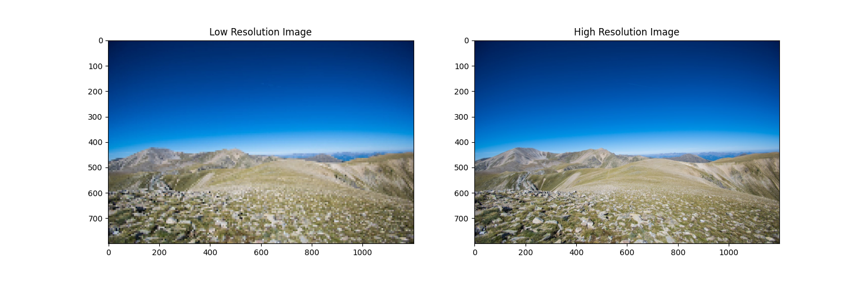
CNN
CNN stands for Convolutional Neural Network, which is a type of artificial neural network designed for processing structured grid data, primarily used for image and video analysis, but also applied to other data types like speech, time series, and more. CNNs are particularly effective for tasks involving visual data due to their ability to automatically learn hierarchical features and patterns.

Slide 42
Thank You

